Slide 1
Lawn Buddy
“The cutting hedge technology”
Final Venture Concept Pitch
Gasser Ahmed
MGT 5824
8/4/2023

Slide 2
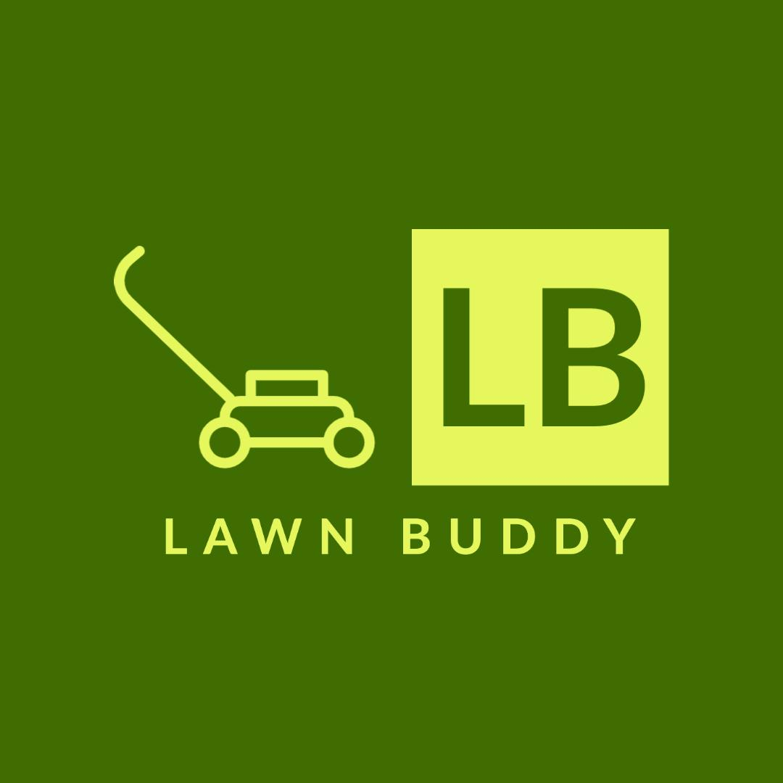





Venture Concept
Convenient and efficient lawn mowing scheduling using AI technology
Time-saving for customers by automating lawn care services
Personalized lawn care plans based on lawn size, location, and specific needs
Reliable and skilled lawn mowing service providers
Real-time updates and notifications for customers
Lawn Buddy
Notes:
30-second elevator pitch summarizing your ‘value proposition canvas’
"Introducing Lawn Buddy: Your ultimate lawn care companion. With cutting-edge AI technology, we bring you convenient and efficient scheduling, tailored to your lawn's unique needs. Imagine saving time as we automate your lawn care services, while skilled professionals ensure a perfectly manicured lawn. Personalized plans, real-time updates, and notifications keep you informed every step of the way. Say goodbye to lawn worries – Lawn Buddy is here to transform your outdoor space hassle-free.

Slide 3
Target Customer Segment
Fill
Notes:
overview of the customer persona(s) for your target customer segment

Slide 4
Key Customer Problem(s)
Fill
Notes:
what are the critical pains, gains, and jobs to be done?

Slide 5
Proposed Solution – MVP
Fill

Slide 6
Problem-Solution Fit & Market Validation
Fill
Notes:
Elaborate on key findings from the customer discovery process validating your proposed solution)

Slide 7
Market Size
Fill
Notes:
what is the total addressable market? What is the size of the market segment(s) you are targeting? Total customer demand? Revenue model?

Slide 8
Competitive Advantage & Value Proposition
Fill

Slide 9
Business Model Overview
Fill

Slide 10
Unit Economics – Gross Margins, Operating Margins, Cashflows
Fill
Notes:
emphasize the scalability of your business model

Slide 11
Growth & Strategy & Funding Needs
Fill
Notes:
how will you finance your growth? Calculate and justify your post-money valuation
PMV = Total Financing Raised/% of equity sold to an investor. For example, if I am raising $5 M and offering 20% of my company’s outstanding equity, my post-money valuation would be $25M

Slide 13









Business Model Canvas
Key Partners
Key Activities
Key Resources
Lawn care service providers (individual contractors or companies)
GPS and mapping services for location tracking
Payment gateway providers
AI and data analytics companies for AI technology integration
Marketing and advertising partners for promoting the app
App development and maintenance
Partnering with lawn care service providers
Integrating AI algorithms for scheduling and route optimization
Customer support and relationship management
Continuous improvement of the AI algorithms and app features
Marketing and promotion of the app
Skilled app developers and designers
AI experts and data scientists
Server infrastructure for data storage and processing
Partnership agreements with lawn care service providers
Marketing and promotional resources
Customer support team
Customer Relationships
Channels
Customer Segments
User-friendly app interface for easy scheduling and communication
Prompt customer support through in-app chat, email, or phone
Regular updates and improvements based on customer feedback
Personalization of lawn care plans to meet individual customer needs
Mobile app stores (e.g., Apple App Store, Google Play Store)
Website for app promotion and customer onboarding
Social media platforms for marketing and advertising
Collaborations with hardware stores or gardening centers
Middle-aged and older residential homeowners with lawns/gardens
Commercial properties with lawns/gardens (e.g., offices, hotels, schools, parks)
Value Proposition
Revenue Model
Cost Structure
Convenient and efficient lawn mowing scheduling using AI technology
Time-saving for customers by automating lawn care services
Personalized lawn care plans based on lawn size, location, and specific needs
Reliable and skilled lawn mowing service providers
Real-time updates and notifications for customers
Commission-based: Charge a percentage of each lawn mowing service payment made through the app.
Subscription model: Offer premium plans with additional features for a monthly or yearly fee.
Advertisements: Allow local lawn care businesses or related companies to advertise within the app.
App development and maintenance costs
AI integration and data analytics expenses
Marketing and advertising costs
Customer support and relationship management expenses
Server hosting and maintenance fees
Operational costs associated with running the platform

Slide 14
Financial Models: Gross Margin Model
Item | Description | June 2023
Revenue:
Commissions from Mowing Services | Revenue generated from commissions charged to service providers (Commission Rate: 10%) | $700,000
Subscription Fees | Revenue earned from premium subscription plans | $20,000
Advertising Revenue | Revenue generated from advertising | $30,000
Total Monthly Revenue | Sum of all revenue sources | $750,000
Cost of Goods Sold (COGS):
Service Provider Payments | Payments made to service providers for lawn mowing services | $550,000
Platform Maintenance and Hosting | Costs for maintaining and hosting the Lawn Buddy platform | $25,000
Customer Support | Expenses related to providing customer support services | $15,000
Total Cost of Goods Sold (COGS) | Sum of all COGS | $590,000
Gross Margin | (Total Monthly Revenue – COGS)/Revenue x 100% | 21.33%

Slide 15
Financial Models: Operating Model
Item | Description | June 2023
Marketing and Advertising | Costs associated with marketing and advertising efforts | $40,000
Research and Development | Investment in enhancing Lawn Buddy's AI capabilities | $25,000
General and Administrative | Overhead expenses for running the business | $35,000
Total Operating Expenses | Sum of all operating expenses | $100,000
Operating Income | Gross Margin - Total Operating Expenses | $60,000
Operating Margin | (Net Income / Total Revenue) x 100% | 8%

Slide 16
Financial Models: Working Capital Model
Item | Description | June 2023
Current Assets
Cash and Cash Equivalents | Cash available for daily operations | $80,000
Accounts Receivable | Amounts due from customers for services provided | $40,000
Total Current Assets: | Sum of all current assets | $120,000
Current Liabilities
Accounts Payable | Amounts owed to service providers and suppliers | $20,000
Accrued Expenses | Outstanding expenses to be paid in the future | $10,000
Total Current Liabilities: | Sum of all current liabilities | $30,000
Working Capital | Total Current Assets - Total Current Liabilities | $90,000

Slide 17
Financial Models: Financing Model
Item | Description | June 2023
Startup Funds
Equity Investment | Capital raised from investors to fund operations | $200,000
Bank Loan | Borrowed funds from a bank to support expansion | $100,000
Total Startup Funds | Sum of all startup funds | $300,000
Startup Costs
Initial Marketing and Advertising | Investment in initial marketing and advertising campaigns | $20,000
Product Research and Development | Funds allocated to enhance Lawn Buddy's AI capabilities | $15,000
Legal and Registration Expenses | Costs associated with legal and company registration | $10,000
Employee Training and Onboarding | Training and onboarding expenses for staff and service providers | $5,000
Technology Infrastructure | Investment in technology and app development infrastructure | $20,000
Total Startup Costs: | Sum of all startup costs | $70,000
Net Startup Funds | Total Startup Funds - Total Startup Costs | $230,000

Slide 18
AI Operating Model: Scalability Analysis
Efficient Scheduling and Resource Allocation: Lawn Buddy leverages AI technology, including object recognition and machine learning, to optimize the scheduling of lawn mowing services. The AI algorithms scan lawns, assess their size, layout, and specific requirements, and then create optimized mowing schedules for service providers. This automation reduces manual effort and ensures that resources are efficiently allocated, allowing Lawn Buddy to handle a larger number of service requests without compromising on service quality or responsiveness.
Automated Lawn Care Services: With the power of AI-driven automation, Lawn Buddy offers customers a seamless and time-saving experience for scheduling lawn care services. Through AI algorithms, the app automatically matches service providers with available time slots, streamlining the entire scheduling process. As Lawn Buddy scales and serves a growing customer base, the automation ensures that the platform can efficiently handle a higher volume of service requests without the need for significant human intervention.
Personalized Lawn Care Plans: AI plays a crucial role in tailoring personalized lawn care plans for each customer. By analyzing customer data, including lawn size, location, and specific preferences, AI algorithms generate personalized recommendations for lawn care. These tailored plans cater to the specific needs of each customer, ensuring a higher level of satisfaction and building strong customer loyalty. As Lawn Buddy expands its user base, AI continues to refine its recommendations to provide a personalized experience to a larger audience.
Real-Time Updates and Notifications: AI-powered real-time updates and notifications keep customers informed throughout the entire lawn care process. Customers receive timely updates about scheduled services, estimated arrival times of service providers, and any changes to the plan. As Lawn Buddy's user base grows, the AI system ensures that all customers receive relevant and timely notifications, fostering better communication and engagement.
Continuous Improvement and Learning: AI's ability to learn from customer interactions and data analysis drives continuous improvement in Lawn Buddy's services. As the platform scales, AI gathers more data, leading to refined algorithms that enhance the accuracy of lawn scanning, scheduling, and personalized recommendations. This continuous learning and improvement enable Lawn Buddy to adapt and stay efficient, meeting customer demands and market challenges effectively as it grows.
Quality Assurance: AI is employed to evaluate service provider performance through customer feedback and reviews. By analyzing past interactions, AI identifies reliable and skilled lawn mowing service providers. This quality assurance mechanism ensures consistent service quality and reliability as Lawn Buddy scales and attracts more service providers to meet growing customer demands. The result is a platform that maintains high-quality standards and fosters trust among its customers.
Notes:
By leveraging AI in these specific ways, Lawn Buddy can efficiently scale its operations, maintain service quality, and deliver a personalized and seamless experience to a growing number of customers. The adaptability and efficiency of AI ensure that Lawn Buddy can continue to meet customer demands and market challenges as it expands its reach and user base.

Slide 19


AI Operating Model: Viability & Sustainability Analysis
Viability
Sustainability
Efficient Scheduling: AI technology utilizes object recognition to scan lawns and assess their size, layout, and specific requirements. Machine learning algorithms then analyze this data to create optimized mowing schedules for service providers. This automated scheduling process reduces manual effort and ensures efficient allocation of resources, contributing to the viability of Lawn Buddy's operations.
Time-Saving Automation: Through AI-driven automation, customers can easily schedule lawn care services through the app. AI algorithms automatically match service providers with available time slots, optimizing the overall scheduling process. This time-saving feature attracts more customers, enhancing the viability of Lawn Buddy as a convenient and efficient lawn care solution.
Personalization for Customer Satisfaction: AI technology analyzes customer data, including lawn size, location, and previous preferences, to create personalized lawn care plans. These plans are tailored to the specific needs of each customer, ensuring high customer satisfaction and loyalty, which is essential for the viability of Lawn Buddy's recurring service model.
Reliable and Skilled Service Providers: AI is used to evaluate service provider performance and customer feedback. By analyzing past customer reviews and ratings, Lawn Buddy can identify reliable and skilled service providers. This quality assurance ensures that customers receive top-notch service, contributing to the viability of the platform.
Scalable and Adaptive Technology: AI algorithms used for scheduling and resource allocation are designed to scale seamlessly as the user base expands. As the demand for lawn care services increases, Lawn Buddy's AI system can handle a larger volume of requests, ensuring sustainability even during peak seasons.
Optimized Resource Allocation: AI optimization techniques help Lawn Buddy efficiently allocate service providers based on location, availability, and skill level. By minimizing travel time and maximizing the number of lawns serviced per day, AI-driven resource allocation reduces fuel consumption and resource waste, promoting sustainable practices.
Data-Driven Decision Making: AI analyzes vast amounts of customer data, feedback, and market trends to make data-driven decisions. By understanding customer preferences and evolving market demands, Lawn Buddy can continuously improve its services, ensuring sustainability by meeting customer expectations effectively.
Real-Time Updates and Customer Engagement: AI-powered real-time updates and notifications keep customers informed about their scheduled services, estimated arrival times, and any changes in plans. This proactive communication enhances customer engagement, satisfaction, and loyalty, contributing to the long-term sustainability of Lawn Buddy.
Notes:
By leveraging AI's capabilities for efficient scheduling, personalized service, resource optimization, and data-driven decision-making, Lawn Buddy creates a scalable and sustainable operating model. The AI-driven features not only enhance the overall customer experience but also contribute to the platform's long-term success and positive environmental impact through optimized resource utilization.

